Slide 1
Conjecture and Proof
Converse, Inverse and Contrapositive Statements. Proof by Contradiction and the Pigeon-Hole Principle.

Slide 2
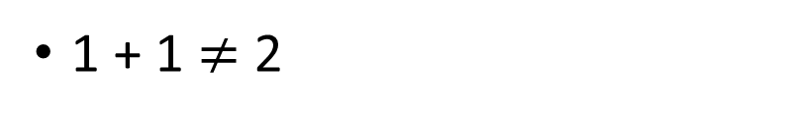
Concept Development: Negation
The negation of P is not P, written as $P^{′}, −P$ or $\overline{P}$.
Statement P
Negation of P (not P)
The Sky is green
(False)
The Sky is not green
(True)
1 + 1 = 2
(True)
1 + 1 $≠$ 2
(False)
All prime numbers are odd
(False)
There exist an even prime number
(True)
All triangles have 3 sides
(True)
Some triangles do not have 3 sides
(False)
Is statement P true or false?
Is the negation of P true or false?
The negation turns a true statement into a false statement, vice versa

Slide 3
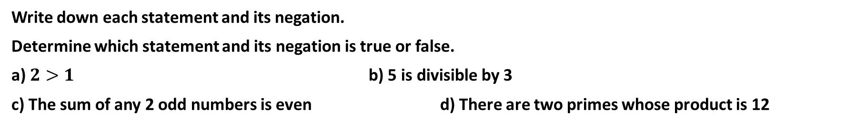
Cambridge Ex 6B Example 6
Write down each statement and its negation.
Determine which statement and its negation is true or false.
a) $2>1$ b) 5 is divisible by 3
c) The sum of any 2 odd numbers is even d) There are two primes whose product is 12

Slide 4
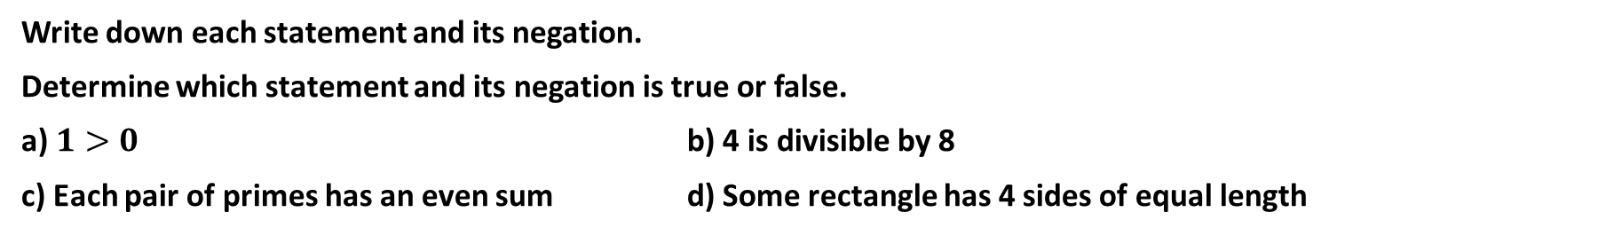
Cambridge Ex 6B Q1
Write down each statement and its negation.
Determine which statement and its negation is true or false.
a) $1>0$ b) 4 is divisible by 8
c) Each pair of primes has an even sum d) Some rectangle has 4 sides of equal length

Slide 5
Concept Development: De Morgan’s law
Negating statements that involved ‘and’ and ‘or’ will apply
De Morgan’s laws:
not (P and Q) is the same as (not P) or (not Q)
not (P or Q) is the same as (not P) and (not Q)

Slide 6
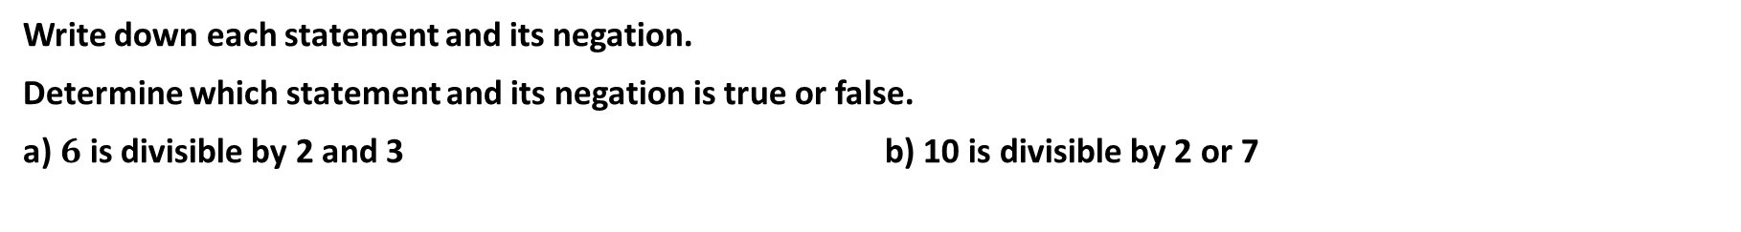
Cambridge Ex 6B Example 7
Write down each statement and its negation.
Determine which statement and its negation is true or false.
a) $6$ is divisible by 2 and 3 b) 10 is divisible by 2 or 7

Slide 7
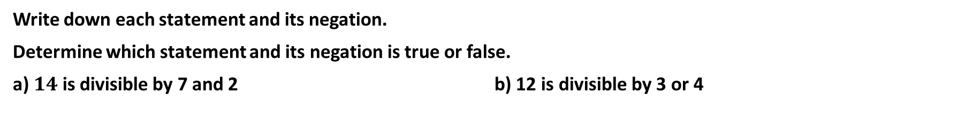
Cambridge Ex 6B Q2
Write down each statement and its negation.
Determine which statement and its negation is true or false.
a) $14$ is divisible by 7 and 2 b) 12 is divisible by 3 or 4

Slide 8
Cambridge Ex 6B Example 8
Every person on an island is either a knight or knave. Knights always tell the truth and knaves always lie.
Alice and Bob are residents on the island. Alice says ‘I am a knave or Bob is a knight’.
What are Alice and Bob?

Slide 9
Cambridge Ex 6B Q3
Every person on an island is either a knight or knave. Knights always tell the truth and knaves always lie.
Alice and Bob are residents on the island. Alice says ‘I am a knave and Bob is a knight’.
What are Alice and Bob?

Slide 10
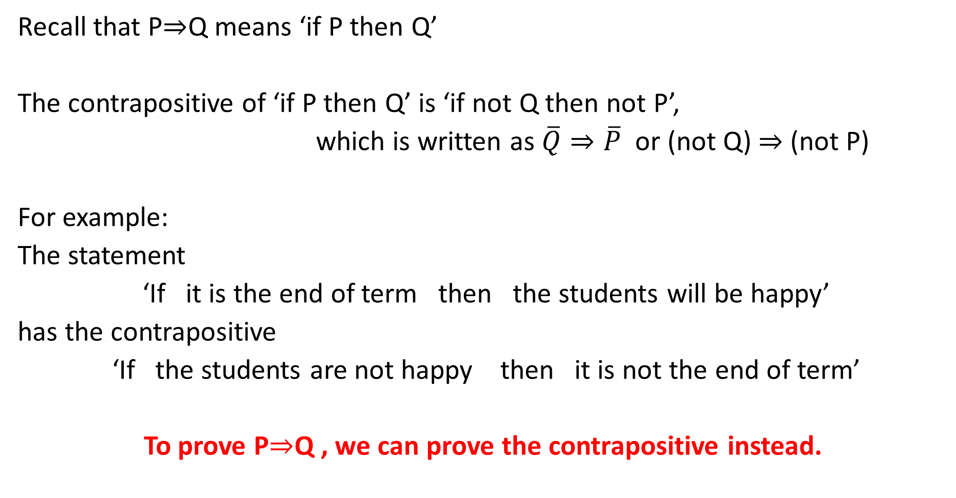
Concept Development: Contrapositive
Recall that P$⇒$Q means ‘if P then Q’
The contrapositive of ‘if P then Q’ is ‘if not Q then not P’,
which is written as $\overline{Q}⇒\overline{P}$ or (not Q) $⇒$ (not P)
For example:
The statement
‘If it is the end of term then the students will be happy’
has the contrapositive
‘If the students are not happy then it is not the end of term’
To prove P$⇒$Q , we can prove the contrapositive instead.

Slide 11
CONTRAPOSITIVE Statements
The contrapositive of ‘If P then Q’ is ‘If not Q then not P’.
For example, if we have the statement:
If x = 2, then x² = 4
The contrapositive is:
If x² ≠ 4, then x ≠ 2
The contrapositive statement is true. In fact, if a statement is true then the contrapositive statement is TRUE.
For example: If a polygon has exactly four sides, then the polygon is a quadrilateral has the contrapositive statement, If the polygon is not a quadrilateral, it does not have exactly four sides. Both these statements are true.

Slide 12


EXAMPLE 3: Contrapositive (SWAP & NEGATE IT)
For each TRUE statement below, find its contrapositive and decide whether or not it is true.
If $x≥3$, then $x^{2}≥9$
If a quadrilateral is a rectangle, then it has diagonals equal in length.
People who live in Tasmania live in Australia.
CONTRAPOSITIVE: If $x^{2}<9$ then $x<3$
This is a true statement.
CONTRAPOSITIVE: If a quadrilateral does not have diagonals equal in length, it is not a rectangle.
This is a true statement.
CONTRAPOSITIVE: People who do not live in Australia do not live in Tasmania.
This is a true statement.
IF a statement is TRUE, the contrapositive will also be TRUE. If a statement is FALSE, the
contrapositive will also be FALSE.

Slide 13

Cambridge Ex 6B Q4
Write down the contrapositive version of the following statements.
If it is raining, then there are clouds in the sky.
If you are smiling, then you are happy.
If $x=1,$ then $2x=2$
If $x>y,$ then $x^{5}>y^{5}$
Let $n∈ℤ$. If $n^{2}$ is odd, then $n$ is odd.

Slide 14
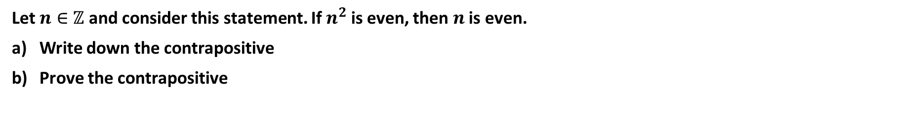
Cambridge Ex 6B Example 9
Let $n∈ℤ$ and consider this statement. If $n^{2}$ is even, then $n$ is even.
Write down the contrapositive
Prove the contrapositive

Slide 15
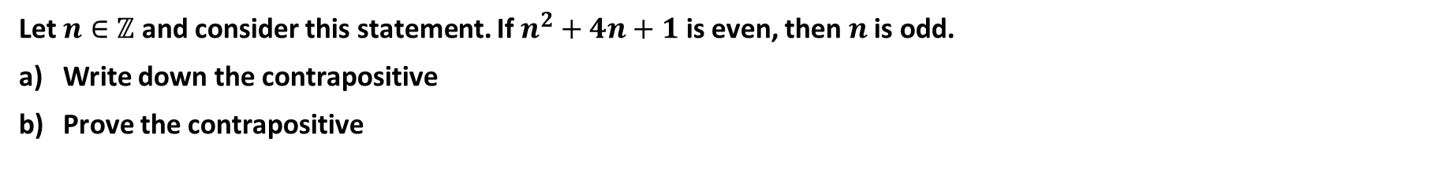
Cambridge Ex 6B Example 10
Let $n∈ℤ$ and consider this statement. If $n^{2}+4n+1$ is even, then $n$ is odd.
Write down the contrapositive
Prove the contrapositive

Slide 16
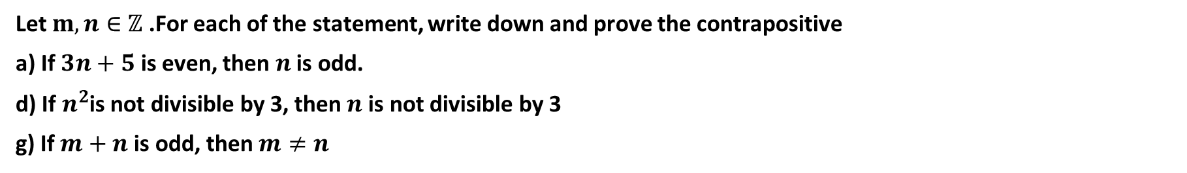
Cambridge Ex 6B Q5
Let $m,n∈ℤ$ .For each of the statement, write down and prove the contrapositive
a) If $3n+5$ is even, then $n$ is odd.
d) If $n^{2}$is not divisible by 3, then $n$ is not divisible by 3
g) If $m+n$ is odd, then $m≠n$

Slide 17
Cambridge Ex 6B Q5
Let $m,n∈ℤ$ .For each of the statement, write down and prove the contrapositive
a) If $3n+5$ is even, then $n$ is odd.
d) If $n^{2}$is not divisible by 3, then $n$ is not divisible by 3
g) If $m+n$ is odd, then $m≠n$

Slide 18
Cambridge Ex 6B Q5
Let $m,n∈ℤ$ .For each of the statement, write down and prove the contrapositive
a) If $3n+5$ is even, then $n$ is odd.
d) If $n^{2}$is not divisible by 3, then $n$ is not divisible by 3
g) If $m+n$ is odd, then $m≠n$

Slide 19
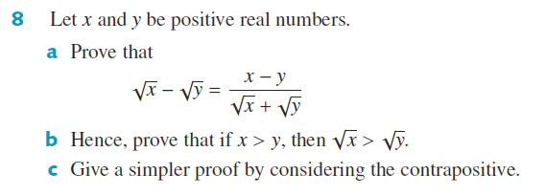
Cambridge Ex 6B Q8

Slide 20
Cambridge Ex 6B Q8

Slide 21
Independent Practice
Cambridge Ex 6B

